Slide 1

ECE 382V: QUANTUM COMPUTING SYSTEMS:
A SOFTWARE/ ARCHITECTURE PERSPECTIVE
Variational Quantum
Algorithms
POULAMI DAS
ECE, The University of Texas at Austin

Slide 2
Quantum Algorithms For Near-Term Systems
Weak guarantees on
quality of solution
Exponential Speedup
Strong guarantees on
quality of solution
Shor’s
Factoring
Quantum
Simulation
Speedup via
Heuristic
Speedup by
complexity
reduction
Approximate
Optimization
(QAOA)
Bernstein
Vazirani
Chemistry
Simulation
VQE
Grover
Search
Can work on NISQ systems, require limited coherence
Requires many gates, qubits, and long coherence times
Polynomial Speedup
NISQ algorithms promise to demonstrate quantum advantage in the next few years

Slide 3
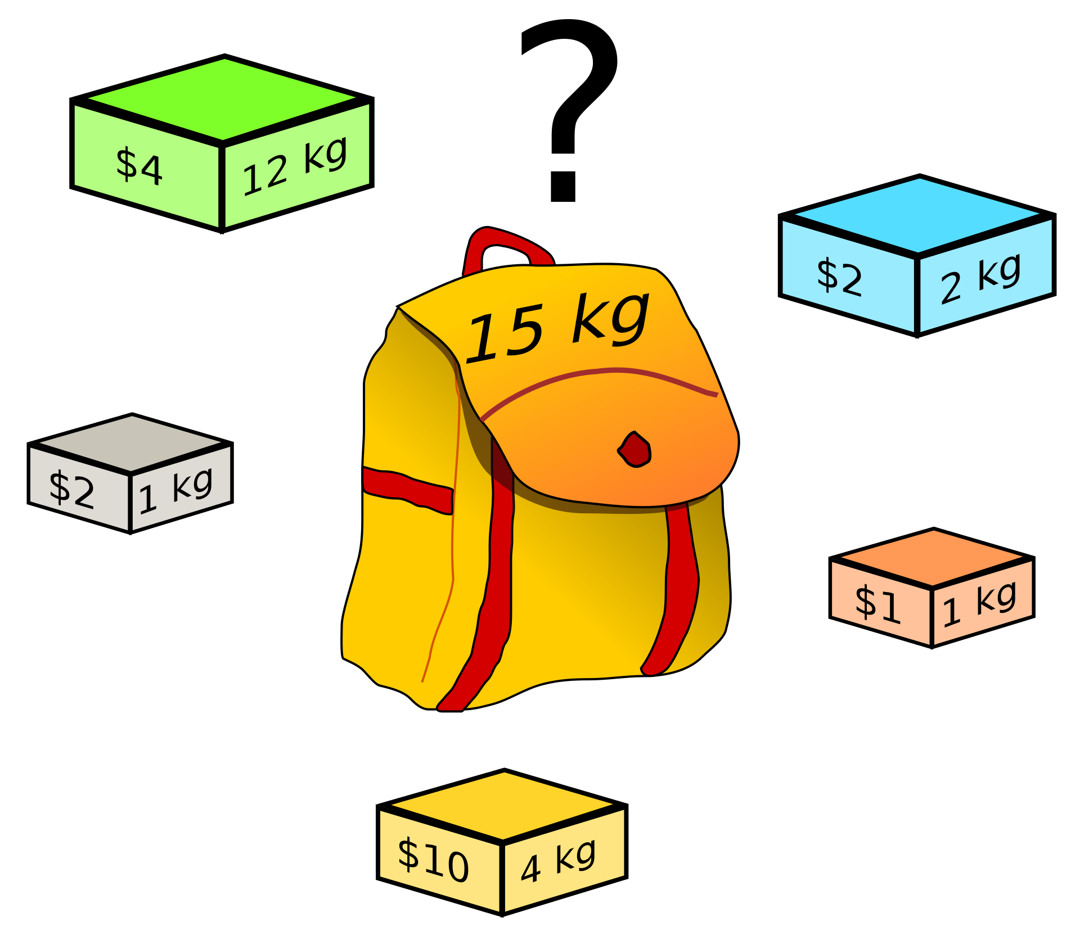
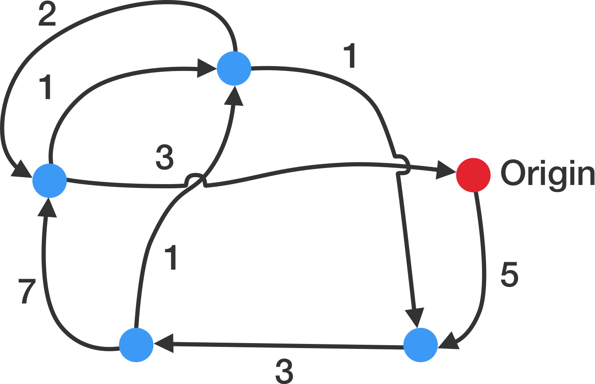
Example Application Domain: Combinatorial Optimization
Traveling Salesman Problem: Given a list of cities and the distances between each pair of cities, what is the shortest possible route that visits each city exactly once and returns to the origin city?
Knapsack Problem: which boxes should be chosen to maximize the amount of money while still keeping the overall weight under or equal to 15 kg?
Many real-world problems are combinatorial optimization problems

Slide 4
Hamiltonian And Energy
The Hamiltonian is an operator that represents the total energy of a quantum system
The Energy of a quantum system in state|𝜓⟩ is given by the expectation value E(|𝜓⟩)
The ground state of a system (|𝜓*⟩) is the state with lowest energy (expectation value)
Can we find the ground state?

Slide 5




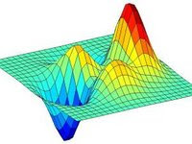
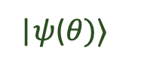
Trial-And-Error Approach/ Variational Method
|𝜓($θ)$⟩
n
U(θ)
q_{n}
Prep trial state or ansatz
Run
Variational Loop
Compute E(θ)
Update 𝜃
Compute Expectation Value
The variational method can estimate the ground state of a quantum system or Hamiltonian

Slide 6
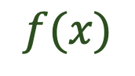

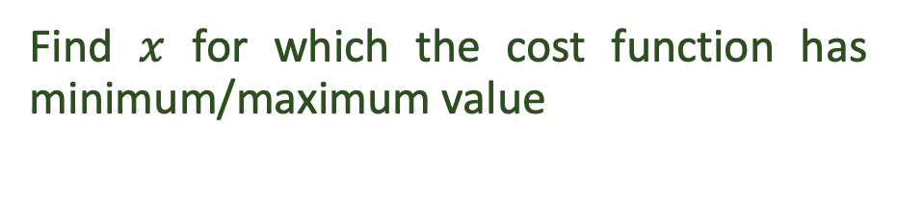
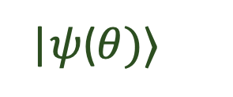
Combination Optimization Using Variational Methods
Cost function
Hamiltonian
$$f(x)$$
|𝜓($θ)$⟩
Combinational
Optimization
Ground state energy estimation
Find $x$ for which the cost function has minimum/maximum value
Find$θ$ for which the energy is minimum
Optimizing a cost function mapped onto finding the ground state energy of a Hamiltonian

Slide 7
Max-Cut Problems
Partition all nodes of given input graph into two set of nodes: Set-0 and Set-1 such that the partition maximizes the number of edges connecting Set-0 nodes to Set-1 nodes
Input Graph
3
0
2
Set-0 Nodes | Set-1 Nodes | Edges cut | Solution String
0, 1, 2 | 3, 4 | E₂₃ and E₂₄ | 11000
1, 2, 3 | 0, 4 | E₀₁ E₀₂ E₂₃ and E₂₄ | 10001
0, 1, 3, 4 | 2 | E₁₂ E₀₂ E₂₃ and E₂₄ | 00100
4
1
Example Cut: {0,1,2} and {3,4}
The 0s and 1s in the solution string corresponds to the two sets

Slide 8
Other Examples Of Max-Cut Problems
1
1
1
2
2
0
0
0
Optimal Cut: {0} and {1}
Optimal Cut: {0,2} and {1}
3
Optimal Cut: {1,3} and {2,0}
Max-cut is a combinatorial optimization problem that can be solved using variational method

Slide 9
QAOA
Quantum Approximate Optimization Algorithm (QAOA)- building circuits, performance of QAOA

Slide 10
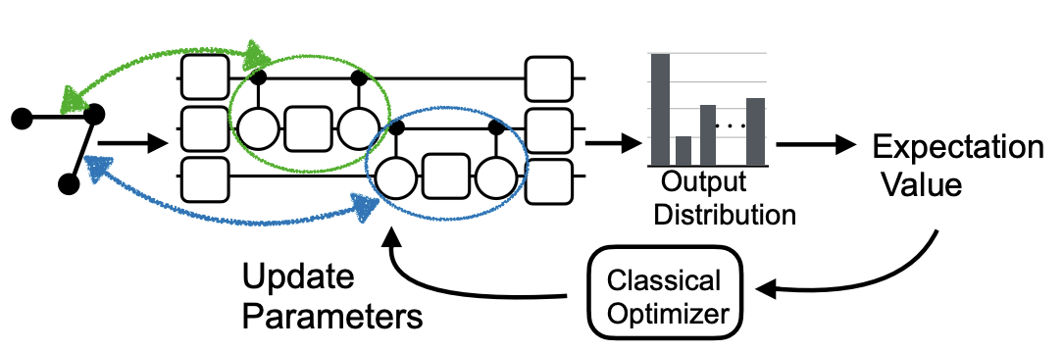
Quantum Approximate Optimization Algorithm (QAOA)
For running QAOA on N node input graph G =(V,E), we need N physical qubits
Nodes of graph (V) are mapped on N physical qubits
Problem cost function is represented by coupling qubits corresponding to E
Edges correspond to parametric CPHASE gates
3 qubits
3 nodes
Real-world problem graph
The problem solution is determined from the output distribution of the optimal circuit

Slide 11
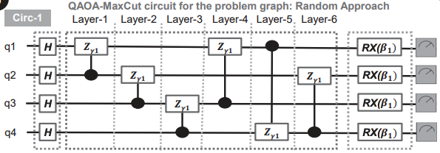
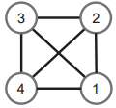
Parameters Of QAOA Circuits
The circuit comprises of two parameters ($γ1 and β1$)
Find optimal $γ1 and β1$
Repeat for p layers to create a QAOA circuit with 2p parameters, increasing complexity with p
Problem graph
QAOA circuit
Higher values of ‘p’ provide greater approximation guarantees

Slide 12
Few Key Takeaways From QAOA Circuit Design
The number of CNOT gates in QAOA circuit depends on the number of edges in input graph
The number of measurement operations scale with the number of nodes in the input graph
The actual number of CNOT gates are much larger due to routing overheads
3x
2x
How does QAOA perform on actual systems?

Slide 13
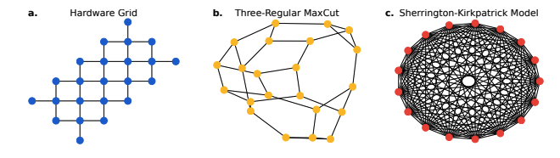
QAOA On Real Quantum Hardware
Google studied the performance of QAOA circuits on their Sycamore device
Three types of graphs were chosen: hardware grid, 3-regular, fully-connected (SK model)
The size of the input graph is increased and the performance is observed
No routing overheads
Theoretical guarantees on quality of solution
Stress-test, maximum routing overheads
Hardware grid
3-Regular
SK Model
How does QAOA perform on Google Sycamore?

Slide 14
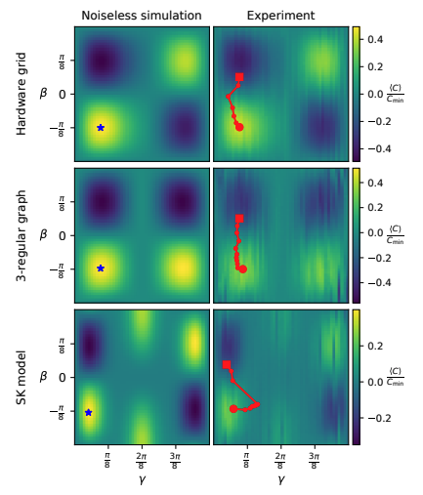
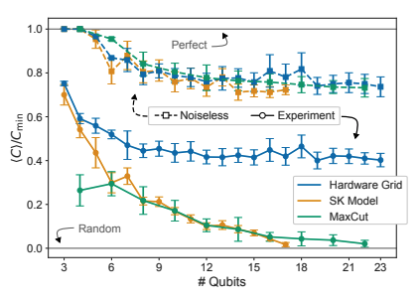
Performance Of QAOA On Google Sycamore
n=23
n=14
n=11
What about QAOA performance with increasing layers (p)?

Slide 15
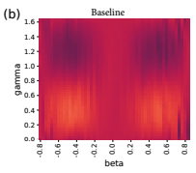
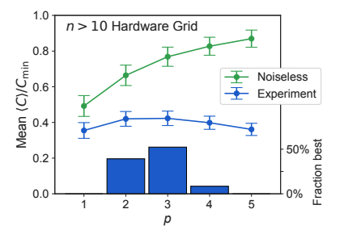
QAOA Performance With Increasing ‘p’ On Sycamore
On real systems, increasing ‘p’ deteriorates performance
Increasing ’p’ leads to more gates making the QAOA circuits more vulnerable to errors
Vanishing gradients/ Barren Plateaus
Google Quantum AI “Quantum Approximate Optimization of Non-Planar Graph Problems on a Planar Superconducting Processor”, 2021
Improving the performance of QAOA is an open problem

Slide 16
VQE and QML
Variational Quantum Eigensolver (VQE) and Quantum Machine Learning (QML)

Slide 17
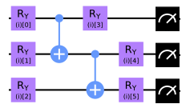
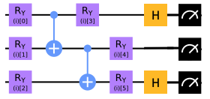
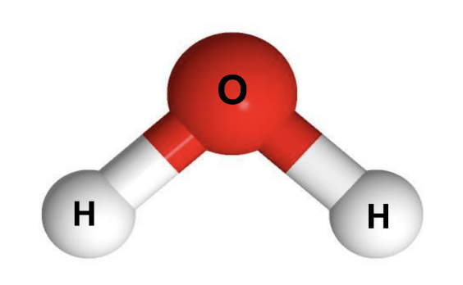
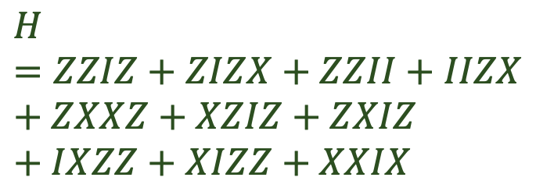
Variational Quantum Eigensolver (VQE)
Used the determine the ground state energy of molecules- enable us to determine chemical reaction rates and understand molecular geometries
Estimating the global optimum with high accuracy is crucial
The Hamiltonian is a linear combination of several Pauli terms (they are obtained by measuring the ansatz in different bases)
The number of terms grow O(N⁴)
$$H=ZZIZ+ZIZX+ZZII+IIZX+ZXXZ+XZIZ+ZXIZ+IXZZ+XIZZ+XXIX$$
ZZZ
XZX
Example: The Cr₂ molecule, which is often considered a benchmark for quantum advantage in molecular chemistry minimally requires around 50 qubits and has nearly 50,000 Pauli terms

Slide 18
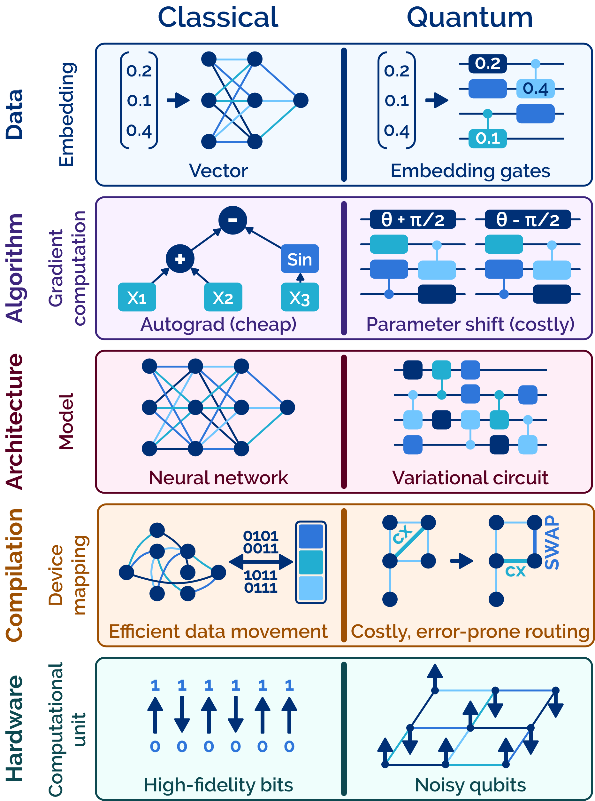
Quantum Machine Learning (QML)
Variational circuits to perform ML tasks
Data embedding to encode classical information using quantum gates
Gradients computed using parameter shift of the VQA parameters (expensive)
Circuits must offer high performance (learning ability) and high noise-resilience
Designing efficient QML circuits is an open problem

Slide 19
How Do We Measure VQA Performance?
Waiting too long reduces performance of software error mitigation
Cloud latencies
Execution Time
Quality Of Solutions
# Operations
Training steps
Transient Faults
Optimization Routine
No gradients
Lack of gradients hurt the training process, increasing number of iterations
We must reduce execution time and impact of noise to improve VQA performance

Slide 20
Approaches For Improving VQA Performance: Overview
Hardware efficient ansatz-> theoretical guarantees?
Instruction re-ordering for enhanced scheduling
Low-overhead application-specific circuit cutting
Reducing impact of transient errors on training performance
Improving the performance of the variational loop
Improving the performance of the optimizer
Reducing total number of iterations in the variational loop
VQA performance improvement requires a full-stack approach

Slide 21
REDUCE IMPACT OF OPERATIONAL ERRORS*
How can we improve scheduling or circuit cutting by leveraging application-specific properties? Goal is to run fewer operations, more compact circuits, reduce overheads of circuit cutting

Slide 22
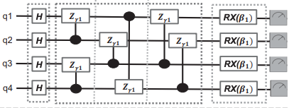
QAOA Specific Instruction Re-ordering
Order the CPHASE blocks such that we maximize concurrency
Problem graph
QAOA circuit
Introduce SWAPs such that CNOTs from the CPHASE and SWAPs cancel
Mahabubul Alam et al. “Circuit Compilation Methodologies for Quantum Approximate Optimization Algorithm”, MICRO 2020
Optimize for higher concurrency by re-ordering operations and gate cancellations

Slide 23
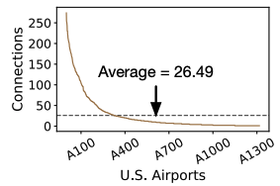
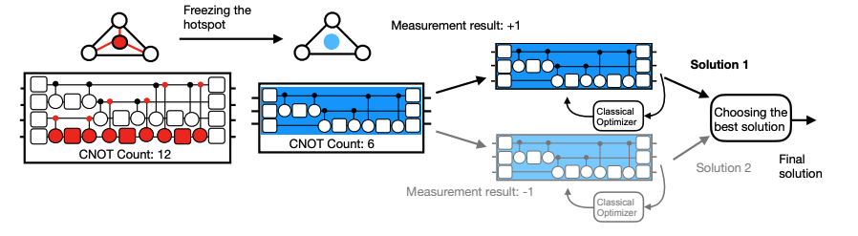
QAOA Specific Low Overhead Circuit Cutting
Real-world problem graphs tend to have hotspots
Freeze the hotspots
Ramin Ayanzadeh et al. “FrozenQubits: Boosting Fidelity of QAOA by Skipping Hotspot Nodes”, ASPLOS 2023
Hotspots contribute maximum number of operations and SWAP overheads in QAOA

Slide 24
REDUCE IMPACT OF TRANSIENT FAULTS
By reducing cloud latencies and number of training steps

Slide 25
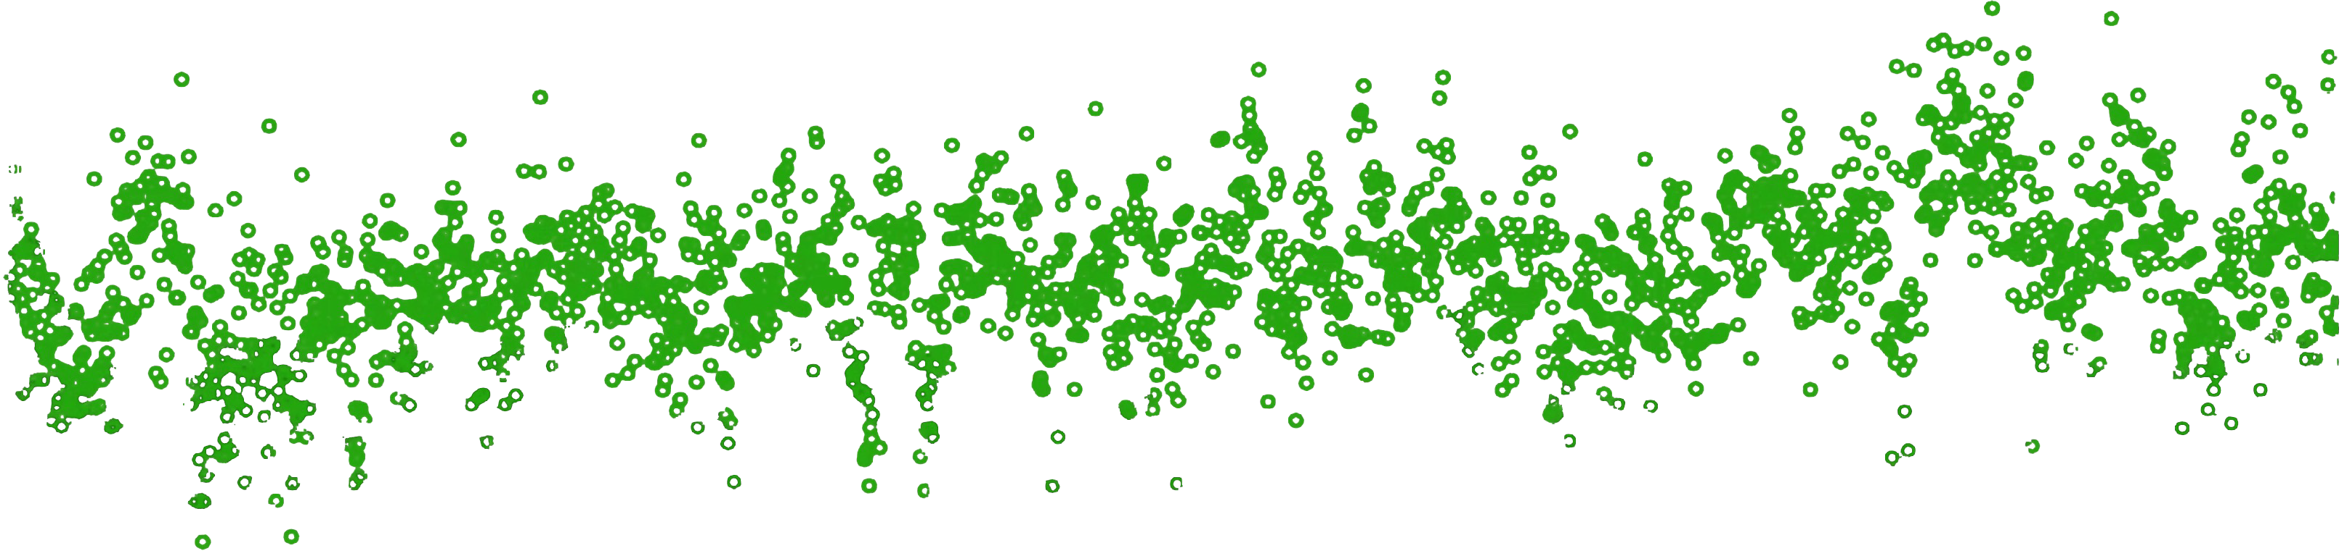
What Are Transient Faults?
Fabrication defects
Parasitic coupling
Two level systems
Thermal ﬂuctuations
Quasi particles
100
75
50
T1 (us)
25
Potential transient errors!
30 40 50
Time (hours)
10
20
60
T1 relaxation: loss of energy of qubit from excited state
|1> to the ground state |0>
Burnett et al. “Decoherence benchmarking of superconducting qubits” NPJ Quantum 2019
Transient faults are hard to fully eliminate at the device-level

Slide 26


Transient Faults Impact Variational Loop Performance
Transient effects
100th ->500th iteration benefit effectively nil
Transient faults may lead to traversal along incorrect paths on the optimization landscape

Slide 27


How Do We Eliminate Transient Faults In VQAs?
i^{th}
VQA Circuit(s)
(i+1)^{th} VQA Circuit(s)
(i+1)^{th} VQA Circuit(s)
(i+1)^{th} VQA Circuit(s)
i^{th}
VQA Circuit(s)
(i+2)^{th} VQA Circuit(s)
(i+2)^{th} VQA Circuit(s)
i^{th}
VQA Circuit(s)
(i+1)^{th} VQA Circuit(s)
(i+2)^{th} VQA Circuit(s)
(i+1)^{th} VQA Circuit(s)
Gokul Ravi et al. “Navigating the dynamic noise landscape of variational quantum algorithms with QISMET”, ASPLOS 2023
By comparing the gradients from both iterations, impact of transient faults can be reduced

Slide 28

Performance Of QISMET
6-qubit TFIM VQA on IBMQ Guadalupe run over a 48-hour period
6-qubit TFIM VQA on IBMQ Sydney run over a 48-hour period
QISMET efficiently mitigates a large portion of the transient noise impact on VQAs and is able to improve the fidelity by 1.3x-3x over a traditional VQA baseline,

Slide 29
REDUCE RUNTIME OF Variational Loop
By reducing cloud latencies, improving classical optimizer performance, and reducing the number of training steps in the variational step

Slide 30
Qiskit Runtime: Improving Variational Loop Performance
Long cloud latency bottlenecks performance of variational quantum algorithms such as QAOA
+
+
+
+
+
+
+
+
Containerized environment
Optimizer
Optimizer
What do we need from services such as Qiskit Runtime?

Slide 31
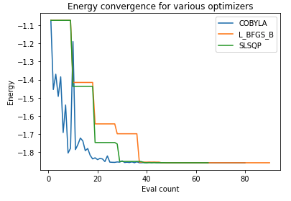
QAOA Performance Depends On Optimizer Performance
Some optimizers can deal with noisy data more efficiently than others
Optimizers like SPSA preferred
Models to improve optimizers for QAOA
Energy convergence for a problem
Kevin Sung et al. “Using models to improve optimizers for variational quantum algorithms”, https://iopscience.iop.org/article/10.1088/2058-9565/abb6d9/ampdf
Poor optimizers may not find the optimal solution and/or takes too long to converge

Slide 32
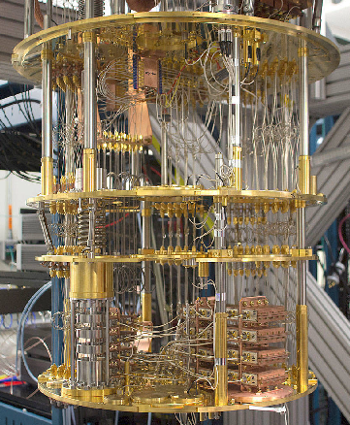
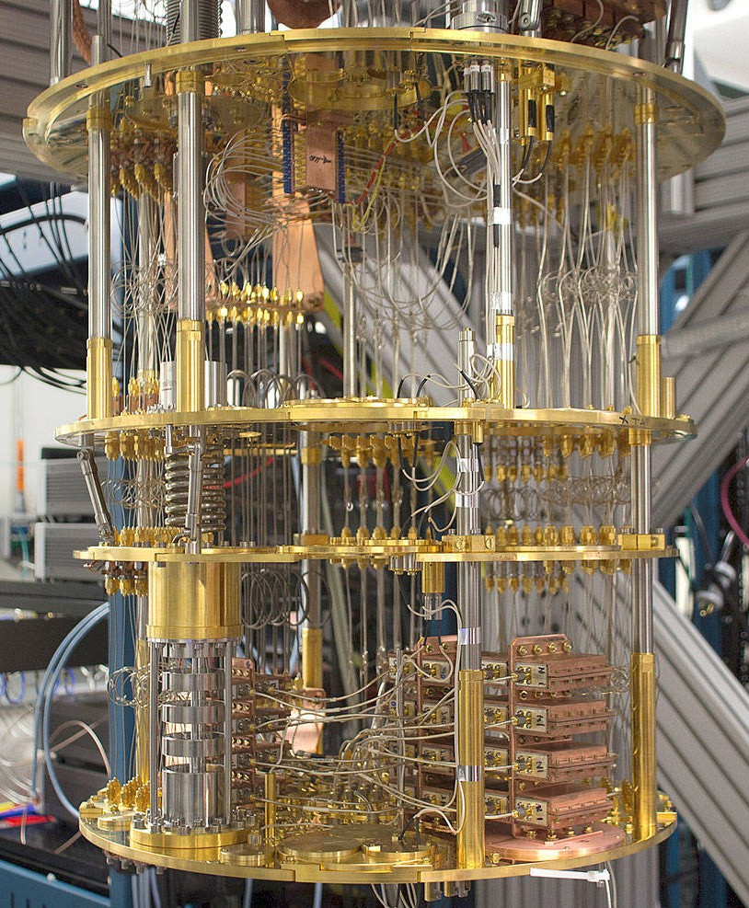







Minimizing Overheads Of VQE Using Clifford Circuits
Portion of the quantum space can be simulated on classical systems efficiently(Clifford space)
Noise induced local minimum
NOISE FREE!!
How can we use the Clifford space to reduce VQE training overheads?

Slide 33



Find The Best Parameters In The Clifford Space
=
Bayesian Optimization
Tuning Parameter
The Clifford circuits enable us to start the search from parameters close to the global optimum

Slide 34


Clifford And Non-Clifford Space
Parameterized ansatz circuit
Clifford + Non-Clifford Space
Clifford Space
A classically intractable general circuit
Continuous angles = [0, 2*pi]
A classically simulable Clifford circuit
Discrete angles = {0, pi/2, pi, 3*pi/2}
Gokul Ravi et al. “CAFQA: A classical simulation bootstrap for variational quantum algorithms”, ASPLOS 2023
For more details on how the Clifford circuits are trained, read the “CAFQA” paper

Slide 35
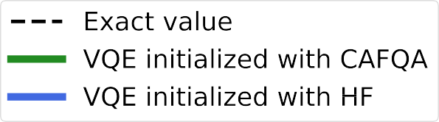
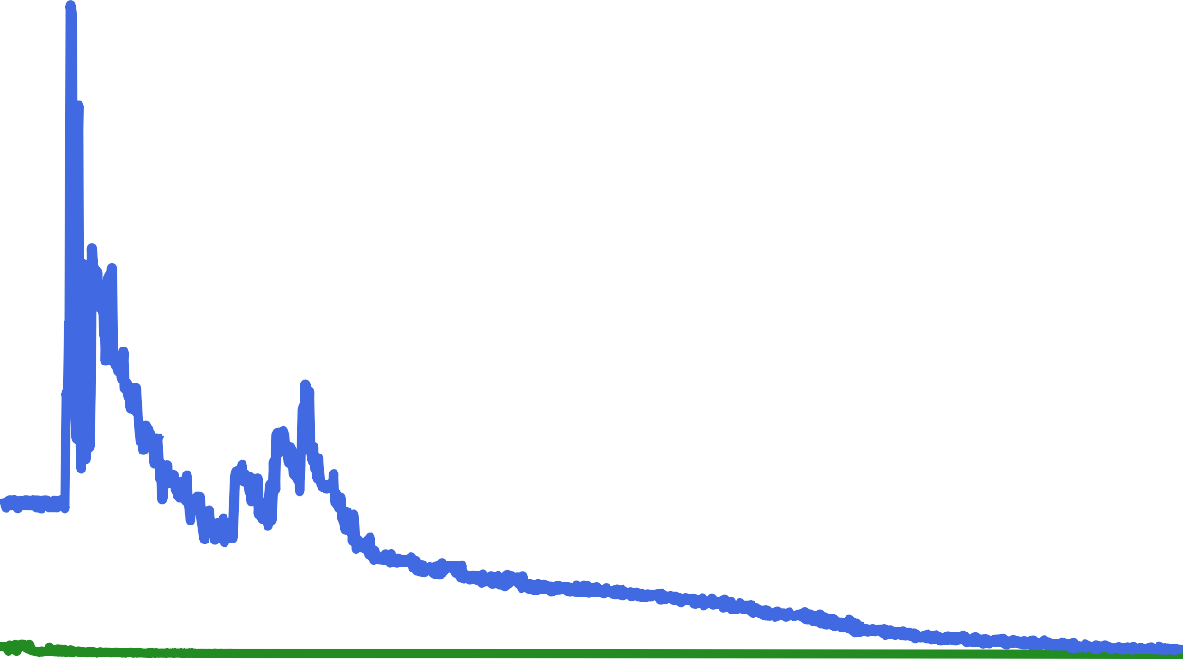


Performance Of CAFQA
Objective
Hartree-Fock initialization [~1930]: Classically-solvable algorithm in molecular chemistry that approximates
/ restricts the problem’s electronic configuration.
CAFQA: 100x higher
HF: 3x worse error
initial accuracy
CAFQA: 80 itns to converge
HF: ~1000 itns to converge (12x worse)
CAFQA achieves similar accuracy with fewer iterations

Slide 36
Key Takeaways From Variational Quantum Algorithms
Limited applicability
Limited speedup
Performance limited by the high error-rates of the quantum hardware
Demonstration of computational advantage using VQAs (such as QAOA) requires us to solve problems involving hundreds of qubits and thousands of quantum operations
Will VQAs offer practical quantum advantage? What does this mean for the quantum field?
Development of NISQ applications is an active area of research

